Slide 1
Disclaimer
Any opinions expressed during this presentation are solely those of the presenter and do not necessarily reflect those of the United States Government, or any agency thereof. Nothing in this presentation is intended to create a binding policy or agreement on behalf of the United States.

Slide 2
Wrongful Convictions: A Prosecutorial Perspective
Ameet Kabrawala
Regional Resident Legal Advisor
U.S. Department of Justice
U.S. Embassy Zagreb, Croatia

Slide 3
Framework
Causes of Wrongful Convictions
Preventive Measures
Corrective Measures

Slide 4
Part 1
Causes of Wrongful Convictions

Slide 5
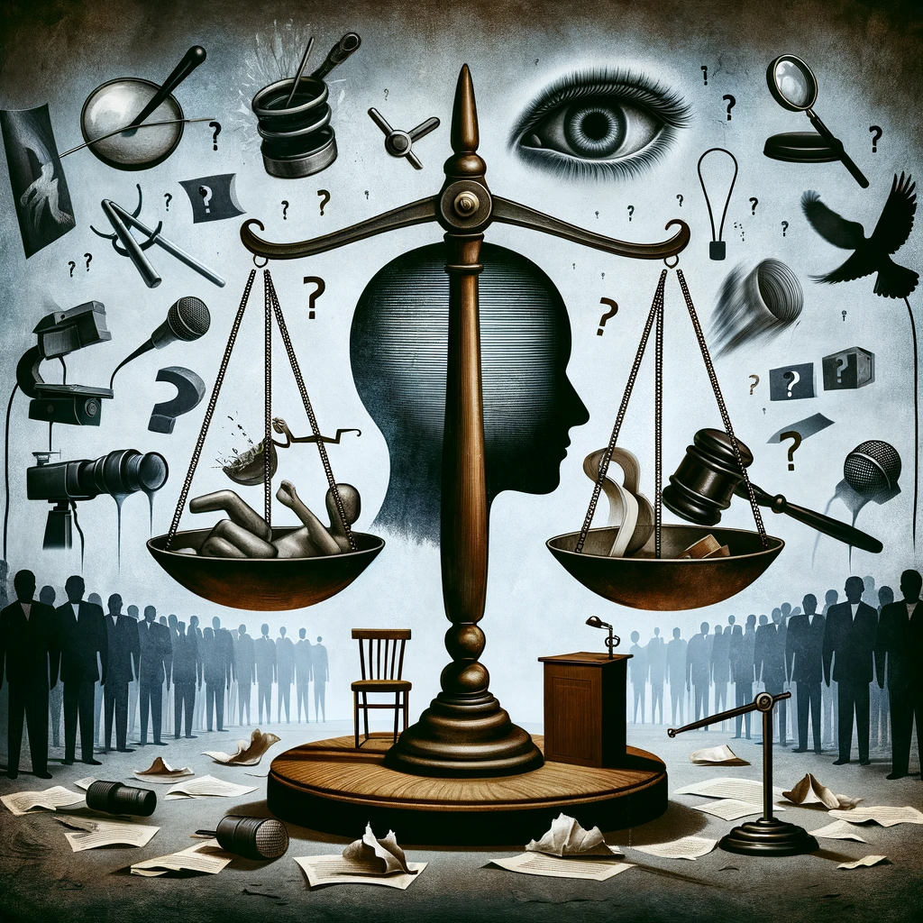
Common Causes of Wrongful Convictions
Eyewitness Misidentification
Forensic Science Misapplications
False Confessions
Official Misconduct
Inadequate Defense
Unreliable or Uncorroborated Informants
Public and Media Pressure
Notes:
Eyewitness Misidentification
Discuss the unreliability of eyewitness accounts.
Influence of suggestive police procedures.
Forensic Science Misapplications
Limitations and misinterpretations of forensic evidence.
Issues with non-validated or improperly performed forensic techniques.
False Confessions
Factors leading to coerced or misled confessions.
Psychological pressure and interrogation tactics.
Official Misconduct
Examples of prosecutorial or police misconduct.
Role of bias or corruption in investigations.
Inadequate Defense
Impact of under-resourced or inexperienced defense attorneys.
Lack of access to necessary resources for a proper defense.
Unreliable Informants
Problems with credibility and motives of informants.
Risks of incentivized testimony.
Public and Media Pressure
Influence of public opinion and media on trials.
Rush to judgment or conviction.

Slide 6
Part 2
Preventative Measures

Slide 7
Preventative Measures
General Measures
Prosecutorial Independence
Prosecutorial Supervision of Investigations
Guided Prosecutorial Discretion
High Ethical Standards
Stringent Rules on Disclosure of:
Exculpatory Information
Prior Witness Statements
Witness Credibility information
Specific Measures
Eyewitness Identification Procedures
Forensic Science Reliability
Interrogation Reforms (recording; PEACE)
Improving Legal Representation
Guidelines on Informant Testimony
Notes:
Prosecutorial Independence
This involves ensuring that prosecutors can make decisions free from political, public, or administrative pressures. Independence is crucial for fair and unbiased prosecution, allowing prosecutors to focus solely on the merits of each case and the pursuit of justice.
Prosecutorial Supervision of Investigations
Prosecutors overseeing investigations can help ensure that they are conducted fairly and thoroughly. This supervision can include guiding the gathering of evidence, ensuring legal compliance, and protecting against investigative biases or misconduct.
Guided Prosecutorial Discretion
This measure involves providing clear guidelines and protocols for prosecutors to make informed decisions, especially in areas like charging, plea bargaining, and pursuing or dropping cases. The aim is to reduce arbitrary or biased decision-making.
High Ethical Standards
Maintaining high ethical standards among all legal professionals, particularly prosecutors, is vital. This includes adherence to principles of justice, transparency, integrity, and accountability. Continuous ethics training and a strong professional code of conduct are essential. Hire the right people who are motivated by the right reasons.
Stringent Rules on Disclosure
These rules mandate that prosecutors must disclose certain types of information to the defense, which includes:
Exculpatory Information
Any evidence or information suggesting the defendant's innocence or mitigating their guilt must be disclosed.
Prior Witness Statements
Disclosure of previous statements made by witnesses can be critical for the defense to identify inconsistencies or biases in witness testimonies.
Witness Credibility Information
Known as Giglio information, this includes any information that could affect a witness's credibility, such as criminal history, incentives for testifying, or past dishonesty. This information is vital for assessing the reliability of witness testimony.
PEACE model of interrogation
Planning
Engage and Explain (rapport)
Account (open-ended Qs; their version of events; summarizing/confirming)
Closure (summarize key points; next steps)
Evaluate (internally evaluate information obtained, assess credibility, and determine if goals of planning met).

Slide 8
Part 3
Corrective Measures

Slide 9
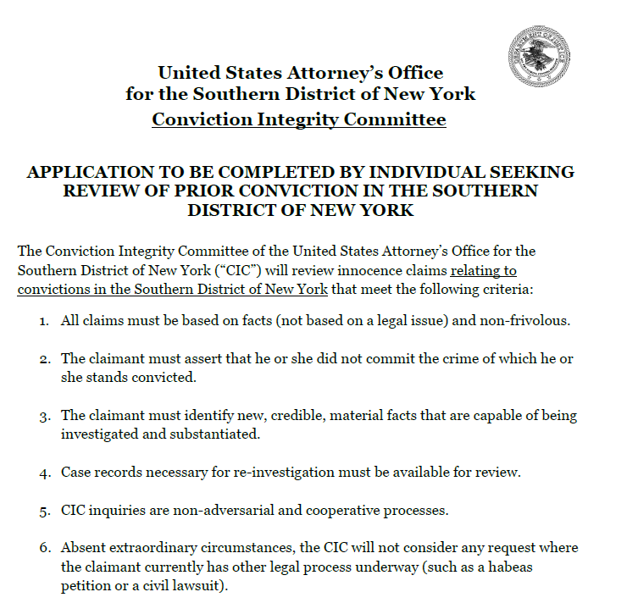
Corrective Measures
Habeas Corpus
Leveraging Technology and Forensics
Partnerships with Innocence Projects
Creating Review Panels or Committees
Notes:
Habeas Corpus
Habeas corpus is a legal petition in court challenging unlawful detention, unlawfulness of court proceedings, or asserting the right to a court review of imprisonment.
Leveraging Technology and Forensics
Utilizing advanced DNA testing methods for more accurate results.
Applying new technologies like artificial intelligence in reviewing case files for signs of wrongful convictions.
Collaboration with Innocence Projects
Partnering with organizations dedicated to exonerating wrongfully convicted individuals.
Facilitating post-conviction reviews and access to evidence for testing.
Creating Review Panels or Commissions
Establishing bodies, including within prosecutors’ offices or independent offices, to review cases of alleged wrongful convictions.
SDNY Example:
All claims must be based on facts (not based on a legal issue) and non-frivolous.
The claimant must assert that he or she did not commit the crime of which he or she stands convicted.
The claimant must agree to cooperate fully with the Unit.
The claimant must identify new, credible, material facts that are capable of being investigated and substantiated.
Case records necessary for re-investigation must be available for review.
CIC inquiries are non-adversarial and cooperative processes.
Absent extraordinary circumstances, the CIC will not consider any request where the claimant currently has other legal process underway (such as a habeas petition or a civil lawsuit).

Slide 10
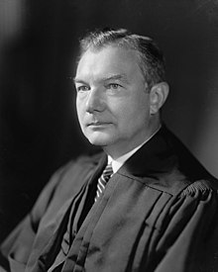
“While the prosecutor at his best is one of the most beneficent forces in our society, when he acts from malice or other base motives, he is one of the worst.”
Robert H. Jackson
Associate Justice of the U.S. Supreme Court
U.S. Attorney General
U.S. Solicitor General
Chief Prosecutor, Nuremberg Trials
Notes:
It would probably be within the range of that exaggeration . . . to say that [the prosecutor] is one of the most powerful peace-time forces known to our country.
The prosecutor has more control over life, liberty, and reputation than any other person in America.
The prosecutor can order arrests. He can cause the citizen to be indicted and held for trial. He may dismiss the case before trial, in which case the defense never has a chance to be heard. Or he may go on with a public trial. If he obtains a conviction, the prosecutor can still make recommendations as to sentence, as to whether the prisoner should get probation or a suspended sentence.
While the prosecutor at his best is one of the most beneficent forces in our society, when he acts from malice or other base motives, he is one of the worst.

Slide 11
Hvala!
Ameet Kabrawala
Regional Resident Legal Advisor
U.S. Department of Justice
KabrawalaA@state.gov

