Slide 1
Identification and Protection of Wrongfully Convicted Persons as Special Type of Victims in Criminal and Misdemeanor Procedure in Croatia
Suncana Roksandic, Faculty of Law in Zagreb
Andrej Bozhinovski, Faculty of Law in Zagreb

Slide 2
Have you ever been wrongfully convicted for a misdemeanor?

Slide 3
Have you ever been wrongfully convicted for a crime?

Slide 4
Have you heard of someone being innocently convicted?

Slide 5
Do you think Wrongfully convicted people should be classified as a special type of victims??

Slide 6
About the Project
1. Aim: The aim of Innocence Project Croatia is to assess the necessity and viability of projects dedicated to addressing wrongful convictions and miscarriages of justice within the Croatian legal system.
2. Objectives:
a. Conduct Comprehensive Research:
b. Raise Awareness:
c. Provide Legal Assistance:
d. Advocate for Reform:

Slide 7
About the Project
3. Activities
a. Legal Case Review:
b. Collaborate with Experts:
c. Public Awareness:
d. Exoneration Efforts:
e. Policy Advocacy
f. Research & Data Collection:
g. International Collaboration:
h. Media Relations:
i. Case Reviews:

Slide 8
Empirical Methods
Revision of 92 cases from the jurisprudence of the four county courts in Croatia.
Conducted interviews with 23 judges, lawyers and prosecutors.
Out-source reach out of the project into North Macedonia, Bosnia and Herzegovina and Serbia.
Detected one case of possible wrongful conviction in the county court in Osijek.
Raising awareness of storage, utilization and gathering od DNA materials.

Slide 9
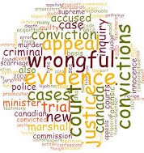
What we are up against
Alignment with Constitutional Principles: right to a fair trial, non bis in idem, and the presumption of innocence.
Criminal Procedure Code and the Constitution: Retention of DNA materials, Revising the criminal procedure, establishing a Novum and reaching the Novum criteria
European Influence: Croatia's EU accession process and the influence of European Court of Human Rights jurisprudence have driven additional reforms in the CCP related to the utilization and storage of DNA materials
High Novum Threshold: The practical application of the novum threshold required for successful revision cases is exceedingly challenging.

Slide 10
Legalities
Article 25 (4) of the Constitution envisages compendations for faulty imprisonment and faulty detention.
Article 32 of the constitution forbids non bis in idem.
Article 498 of the Criminal Procedure Code envisages improper revision of the criminal procedure in the part of the sentence.
Article 501 of the Criminal Procedure Code envisages proper revision of the criminal procedure.

Slide 11
Identification of Wrongful Convicted persons

Slide 12
How to identify
1. Case Review and Screening:
2. Evidence Examination:
3. Forensic Analysis:
4. Witness Interviews and Alibi Verification:
5. Legal Review and Post-Conviction Relief:

Slide 13
Causes of Wrongful Convictions in Croatia
Most notable detected causes:
False Confessions
Forensic Errors
Plea-bargain

Slide 14
False Confessions
False confessions from a witness or Expert.
It takes confessions into account only to allow the trial to commence without a preliminary hearing if the suspect has confessed during the interrogation.
Despite the obligation for determining the material truth, practical experiences shows that confessions end up playing a decisive role in day-to-day judicial experience and shed their light on the whole pre-trial investigation phase.

Slide 15
Faulty DNA Expertise and Treatment
DNA evidence is double edged sword that guarantees certain conviction, if the expertise is conducted properly or miscarriage of justice if done improperly.
DNA data in Croatia from convicted person is retained for 20 years.
10>more = 40 years from the end of the criminal proceedings.
Acquittal, suspension of criminal proceedings or dismissal of charges, these data are kept for 10 years from the end of the proceedings.

Slide 16
ECtHR and Treatment of DNA
Current legal provisions are not in line with the Marper standard of the ECtHR.
New Evidence standards must apply to new scientific evidence (DNA testing and other examinations)
Ocalan v. Turkey By applying the margin of appreciation in each case, the Court had demonstrated that not considering new evidence may infringe on the right to a fair trial.

Slide 17
Plea - Bargain
Procedure which involves confession of guilt and waives the right of an appeal (regardless of whether the defendant committed the crime or not)
Tool for efficiency of the criminal procedure on the burden on the procedural rights of the defendant.
No safe guards in procedural rights.

Slide 18
Retrial and Establishing a Novum

Slide 19
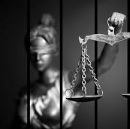
Types of Revision:
Croatia's revision of the criminal procedure is rooted in its Code of Criminal Procedure, but there are discrepancies between the Croatian Code of Criminal Procedure and the Constitution regarding which judicial decisions can be revised.
Legal practitioners in Croatia perceive the high threshold for meeting the "novum" criteria as a significant challenge, leading to calls for further legal reforms to lower this threshold and ensure a fair opportunity for revision.

Slide 20
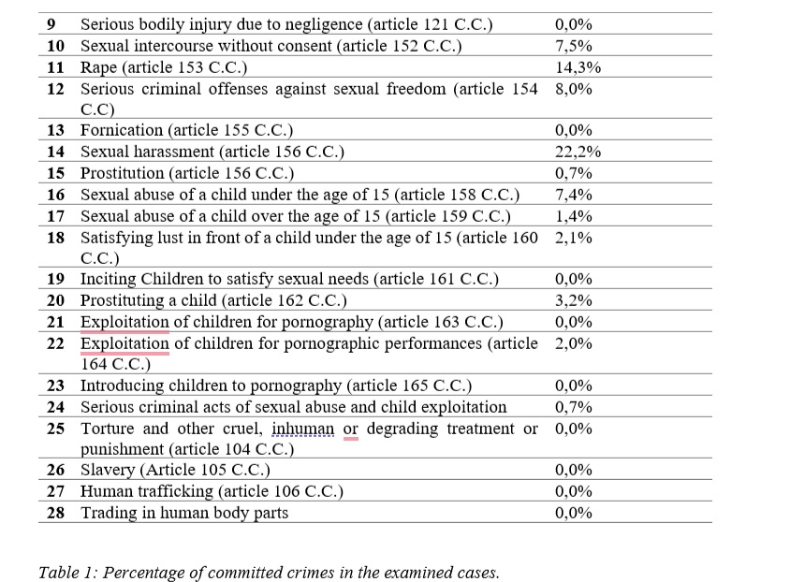
Practical Aspects in Revision of Proceedings

Slide 21
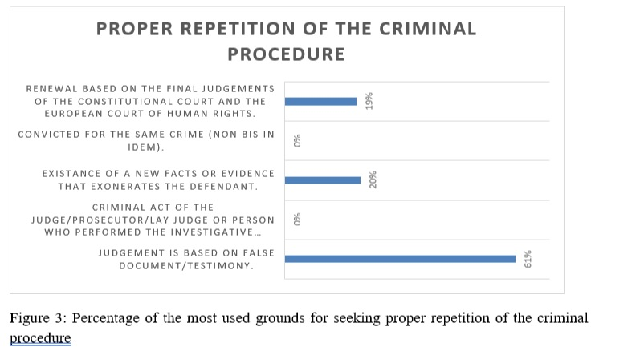
Practical Aspects in Revision of Proceedings

Slide 22
Types of Revision - Croatia:
(a) improper revision
(b) Revision in cases where the indictment is rejected;
(c) revision of the completed criminal procedure before the indictment;
(d) Proper revision after the valid judgment;
(e) Revision in malam partem;
(f) Revision in absentia
(g) Revision on the grounds of decisions of the Constitutional Court of Croatia and the European Court of Human Rights

Slide 23
Revision Commissions – something to think about:
Dutch CEAS Commission
French Judicial Commission model
Belgian commission model

Slide 24
Rights of the Wrongfully convicted
| Legal Rights Cluster | Compensation and Support Cluster | Reintegration and Support Cluster |
|-----------------------------|---------------------------------|----------------------------------|
| - Right to a Fair Trial | - Right to a Speedy Resolution | - Right to Reintegration |
| - Right to Appeal | - Right to Non-Retaliation | |
| - Right to Post-Conviction | - Right to Public Awareness | |
| Review | | |
| - Right to Legal Assistance | | |
| - Right to Access Evidence | | |

Slide 25
Flagged Cases
Medical expertise at the time only confirmed hematomas on the left and right breast which the expert concludes that are made by compression by other person while the victim was immobilized. Gynecological expertise concluded that she was not a virgin at the time of the crime, and no vaginal injuries were determined at that time.
DNA sample was taken but never examined.
Court confirmed the first penalty in the new case and dismissed the deposition of the victim and never ordered new DNA expertise.

Slide 26
Recommendations
Advocate for Lowering the Novum Threshold:
The Innocence Project Croatia should actively advocate for legal reforms to lower the threshold for meeting the "novum" criteria required for the revision of criminal cases. This can make it more accessible for wrongfully convicted individuals to seek justice when new evidence or legal errors come to light. Consider adopting the Dutch or French Model.
Raise Public Awareness and Support:
The project should continue to raise public awareness about miscarriages of justice in Croatia. Building support and understanding within the public can help garner more resources and attention for cases of wrongful conviction.
Collaborate with Legal Experts:
Collaborate with legal experts, scholars, and lawmakers to influence legislative changes that align with international best practices in criminal justice. This can involve engaging in dialogue and providing research and data to support proposed reforms.
Provide Comprehensive Reintegration Support:
Recognizing that exonerees often face significant challenges upon release, the Innocence Project Croatia should expand its efforts to provide comprehensive reintegration support. This may include assistance with finding housing, employment, and mental health services to help exonerees transition successfully back into society.
Document and Share Best Practices:
The project should document its experiences and best practices in advocating for wrongfully convicted individuals. Sharing this knowledge, including successful legal strategies and advocacy techniques, can benefit similar initiatives in other jurisdictions and contribute to the broader global movement for justice reform.

Slide 27
Thank you for your attention
Suncana.roksandic@pravo.hr
Abozinovski@pravo.hr

